Slide 1
Theory of Formal Language
Solutions for First Internal Test – Feb 2024
International Institute of Professional Studies, Devi Ahilya University, Indore
Submitted To : Dr.Shaligram Prajapat
Submitted By : Rishika Pathak(IC-2K20-68)

Slide 2
Table of Contents
Introduction
Question 1
Question 2
Question 3
Question 4
Question 5
Question 6
Question 7
Question 8
Question 9
Question 10

Slide 3



Introduction
Assignment Overview
This presentation provides an introduction to formal languages and grammars. We will cover a subset of English grammar, postfix notation grammar, Extended Backus–Naur Form (EBNF), and examples and derivations.
Rules for Constructing Valid Sentences
Sentences must contain a subject and a predicate.
The subject and predicate must agree in number and tense.
Sentences must have proper punctuation, including capitalization at the beginning and appropriate punctuation at the end.
Sentences should be grammatically correct and coherent.

Slide 4
Subset of English Grammar
Noun Phrase (NP)
NP → Proper Noun
NP → Article Noun
NP → Article Adjective Noun
Verb Phrase (VP)
VP → Verb
VP → Verb NP
VP → Verb NP PP
Prepositional Phrase (PP)
PP → Preposition NP
Sentence (S)
S → NP VP
S → NP VP PP
Valid Sentences
John runs.
The cat jumps.
The big dog barks.
The cat eats the mouse.
The dog chases the cat.
The book is on the table.
The cat is under the chair.

Slide 5
Q.1) Use the set of productions to show that each of these sentences is a valid sentence. a)the happy hare runs b)the sleepy tortoise runs quickly c)the tortoise passes the hare d)the sleepy hare passes the happy tortoise
c) the tortoise passes the hare
sentence → noun phrase transitive verb phrase noun phrase
noun phrase → article noun
transitive verb phrase → transitive verb
article → the
noun → tortoise
transitive verb → passes
noun → hare
a) the happy hare runs
sentence → noun phrase intransitive verb phrase noun phrase
noun phrase → article adjective noun
intransitive verb phrase → intransitive verb
article → the
adjective → happy
noun → hare
intransitive verb → runs
d) the sleepy hare passes the happy tortoise
sentence → noun phrase transitive verb phrase noun phrase
noun phrase → article adjective noun
transitive verb phrase → transitive verb
article → the
adjective → sleepy
noun → hare
transitive verb → passes
noun phrase → article adjective noun
article → the
adjective → happy
noun → tortoise
b) the sleepy tortoise runs quickly
sentence → noun phrase intransitive verb phrase noun phrase
noun phrase → article adjective noun
intransitive verb phrase → intransitive verb adverb
article → the
adjective → sleepy
noun → tortoise
intransitive verb → runs
adverb → quickly

Slide 6
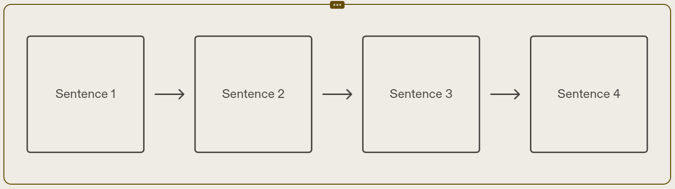
Q.2) Construct derivation trees for the sentences in Questions
Derivation trees A derivation tree represents the step-by-step process of generating a sentence in a formal grammar. Each node in the tree corresponds to a production rule in the grammar, and the leaves represent the words in the sentence.
Sentence 1
Explanation of the derivation steps for Sentence 1.
Sentence 2
Explanation of the derivation steps for Sentence 2.
Sentence 3
Explanation of the derivation steps for Sentence 3.
Sentence 4
Explanation of the derivation steps for Sentence 4.

Slide 7
Q.2) Construct derivation trees for the sentences in Questions
a) The happy hare runs
Sentence
Noun phrase
Intransitive Verb Phrase
article
adjective
noun
Intransitive Verb
the
happy
hare
runs

Slide 8
Q.2) Construct derivation trees for the sentences in Questions
b) The sleepy tortoise runs quickly
Sentence
Noun phrase
Intransitive Verb Phrase
article
adjective
noun
Intransitive Verb
adverb
the
sleepy
tortoise
runs
quickly

Slide 9
Q.2) Construct derivation trees for the sentences in Questions
c) The tortoise passes the hare
Sentence
Noun phrase
Noun phrase
Intransitive Verb Phrase
article
noun
Intransitive Verb
article
noun
the
tortoise
passes
the
tortoise

Slide 10
Q.2) Construct derivation trees for the sentences in Questions
d) The sleepy hare passes the happy tortoise
Sentence
Noun phrase
Intransitive Verb Phrase
article
adjective
noun
Intransitive Verb
the
happy
hare
runs

Slide 11
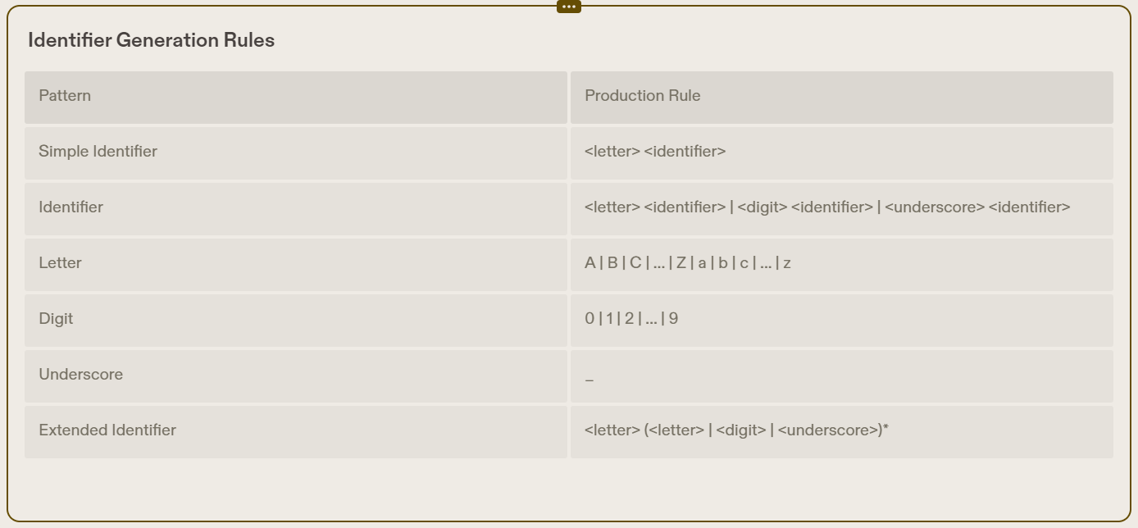
Q.3)
a) Construct a phrase-structure grammar
Phrase-Structure Grammar
A phrase-structure grammar is a formal grammar that describes the structure of a language by defining a set of rules that specify how phrases can be formed from smaller constituents. In the context of signed decimal numbers, we can construct a phrase-structure grammar to define the syntax of these numbers.

Slide 12
Q.3)
a) Construct a phrase-structure grammar
# Define the grammar rules
grammar = nltk.CFG.fromstring(
''' S -> Sign Number
Sign -> '+' | '-’
Number -> Integer '.' Integer
Integer -> Digit Integer | Digit
Digit -> '0' | '1' | '2' | '3' | '4' | '5' | '6' | '7' | '8' | '9' '‘’
)
# Create a parser
parser = nltk.ChartParser(grammar)
# Parse a signed decimal number
parse_tree = next(parser.parse(['-', '3', '.', '14'])) print(parse_tree)
Code Segments
Here are some code segments that illustrate how to implement a phrase-structure grammar for signed decimal numbers:
S -> Sign Number
Sign -> '+' | '-’
Number -> Integer '.' Integer Integer -> Digit Integer | Digit Digit -> '0' | '1' | '2' | '3' | '4' | '5' | '6' | '7' | '8' | '9'

Slide 13
Q.3)
Construct a phrase-structure grammar that generates all signed decimal numbers, consisting of a sign, either + or − ; a nonnegative integer ; and a decimal fraction that is either the empty string or a decimal point followed by a positive integer, where initial zeros in an integer are allowed.
Give the Backus–Naur form of this grammar
Phrase-Structure Grammar:
signed_decimal → sign nonnegative_integer decimal_fraction
sign → '+' | '-’
nonnegative_integer → digit | digit nonnegative_integer
decimal_fraction → epsilon | '.' positive_integer
positive_integer → digit | digit positive_integer
digit → '0' | '1' | '2' | '3' | '4' | '5' | '6' | '7' | '8' | '9’
epsilon → ε
Backus-Naur Form (BNF):
signed_decimal ::= sign nonnegative_integer decimal_fraction
sign ::= '+' | '-’
nonnegative_integer ::= digit | digit nonnegative_integer
decimal_fraction ::= epsilon | '.' positive_integer
positive_integer ::= digit | digit positive_integer
digit ::= '0' | '1' | '2' | '3' | '4' | '5' | '6' | '7' | '8' | '9’
epsilon ::= ε

Slide 14
Q.3)
c) Give production rules in Backus–Naur form for an identifier if it can consist of
one or more lowercase letters.
at least three but no more than six lowercase letters.
one to six uppercase or lowercase letters beginning with an uppercase letter.
a lowercase letter, followed by a digit or an under score, followed by three or four alphanumeric characters (lower or uppercase letters and digits)
1.) ⟨identifier⟩ ::= ⟨lcletter⟩ | ⟨identifier⟩⟨lcletter⟩
⟨lcletter⟩ ::= a | b | c | ⋯ | z
4.) ⟨identifier⟩ ::= ⟨lcletter⟩⟨digitorus⟩⟨alphanumeric⟩⟨alphanumeric⟩⟨alphanumeric⟩ |
⟨lcletter⟩⟨digitorus⟩⟨alphanumeric⟩⟨alphanumeric⟩⟨alphanumeric⟩⟨alphanumeric⟩
⟨digitorus⟩ ::= ⟨digit⟩ | ⟨underscore⟩
⟨alphanumeric⟩ ::= ⟨letter⟩ | ⟨digit⟩
⟨letter⟩ ::= ⟨lcletter⟩ | ⟨ucletter⟩
⟨lcletter⟩ ::= a | b | c | ⋯ | z
⟨ucletter⟩ ::= A | B | C | ⋯ | Z
⟨digit⟩ ::= 0 | 1 | 2 | ⋯ | 9
⟨underscore⟩ ::= _
2.) ⟨identifier⟩ ::= ⟨lcletter⟩⟨lcletter⟩⟨lcletter⟩ |
⟨lcletter⟩⟨lcletter⟩⟨lcletter⟩⟨lcletter⟩ |
⟨lcletter⟩⟨lcletter⟩⟨lcletter⟩⟨lcletter⟩⟨lcletter⟩ |
⟨lcletter⟩⟨lcletter⟩⟨lcletter⟩⟨lcletter⟩⟨lcletter⟩⟨lcletter⟩
⟨lcletter⟩ ::= a | b | c | ⋯ | z
3.) ⟨identifier⟩ ::= ⟨ucletter⟩ |
⟨ucletter⟩⟨letter⟩ |
⟨ucletter⟩⟨letter⟩⟨letter⟩ |
⟨ucletter⟩⟨letter⟩⟨letter⟩⟨letter⟩ |
⟨ucletter⟩⟨letter⟩⟨letter⟩⟨letter⟩⟨letter⟩ |
⟨ucletter⟩⟨letter⟩⟨letter⟩⟨letter⟩⟨letter⟩⟨letter⟩
⟨letter⟩ ::= ⟨lcletter⟩ | ⟨ucletter⟩
⟨lcletter⟩ ::= a | b | c | ⋯ | z
⟨ucletter⟩ ::= A | B | C | ⋯ | Z

Slide 15
Q.3)
d) Give production rules in Backus–Naur form that generates all identifiers in the C programming language. In Can identifier starts with a letter or an underscore ( ) that is followed by one or more lowercase letters, uppercase letters, underscores, and digits.
⟨identifier⟩ ::= ⟨letterorus⟩ ∣ ⟨identifier⟩⟨symbol⟩
⟨letterorus⟩ ::= ⟨letter⟩ ∣
⟨symbol⟩ ::= ⟨letterorus⟩ ∣ ⟨digit⟩
⟨letter⟩ ::= ⟨lcletter⟩ ∣ ⟨ucletter⟩
⟨lcletter⟩ ::= a ∣ b ∣ c ∣ ⋯ ∣ z
⟨ucletter⟩ ::= A ∣ B ∣ C ∣ ⋯ ∣ Z
⟨digit⟩ ::= 0 ∣ 1 ∣ 2 ∣ ⋯ ∣ 9

Slide 16
Extended Backus–Naur Form (EBNF)
Production Rules:
The ? metacharacter represents an optional element. It indicates that the preceding element can occur zero or one time.
The * metacharacter represents a repetition. It indicates that the preceding element can occur zero or more times.
The + metacharacter represents a repetition. It indicates that the preceding element must occur one or more times.
Examples:
Optional Element: The production rule A ::= B ? C indicates that element B is optional. It can occur zero or one time in the production.
Repetition: The production rule A ::= B * C indicates that element B can occur zero or more times in the production.
Repetition: The production rule A ::= B + C indicates that element B must occur one or more times in the production.

Slide 17
Q.4) Give production rules in extended Backus–Naur form that generate all decimal numerals consisting of an optional sign, a nonnegative integer, and a decimal fraction that is either the empty string or a decimal point followed by an optional positive integer optionally preceded by some number of zeros
numeral ::= sign? nonzerodigit digit∗ decimal? ∣ sign? 0 decimal?
sign ::= + ∣ −
nonzerodigit ::= 1 ∣ 2 ∣ ⋯ ∣ 9
digit ::= 0 ∣ nonzerodigit
decimal ::= .digit∗
Q.5) Give production rules in extended Backus–Naur form for identifiers in the C programming language
identifier ::= letterorus symbol ∗
letterorus ::= letter ∣
symbol ::= letterorus ∣ digit
letter ::= lcletter ∣ ucletter
lcletter ::= a ∣ b ∣ c ∣ ⋯ ∣ z
ucletter ::= A ∣ B ∣ C ∣ ⋯ ∣ Z
digit ::= 0 ∣ 1 ∣ 2 ∣ ⋯ ∣ 9

Slide 18
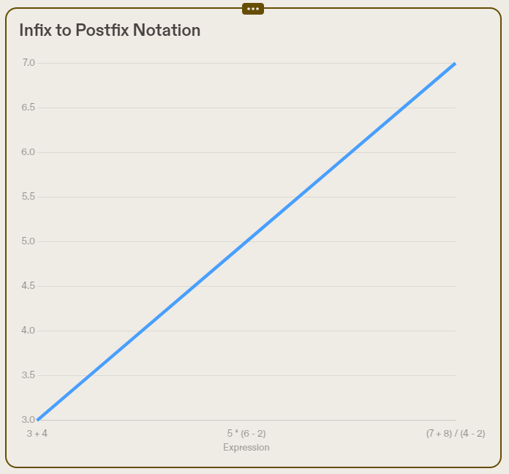
Postfix Notation:
Infix notation is the commonly used arithmetic or logical formula notation. In this notation, operators are written between operands. For example, the infix expression '3 + 4' has the operator '+' between the operands 3 and 4. However, in postfix notation, operators are written after the operands. For the same expression, the postfix notation would be '3 4 +'.
Infix Notation
Infix notation is a common way of writing arithmetic expressions where the operators are placed between the operands. For example, the infix notation for the expression '2 + 3' is '2 + 3'. Infix notation is widely used in mathematics and programming languages.
In contrast to infix notation, there are other notations such as prefix notation (also known as Polish notation) and postfix notation (also known as Reverse Polish notation). These notations have different rules for placing operators and operands, and they are often used in stack-based algorithms and calculators.

Slide 19
Q.6) For each of these strings, determine whether it is generated by the grammar given for postfix notation. If it is,find the steps used to generate the string
abc∗+
xy++
xy−z∗
wxyz−∗∕
ade−∗
ade−∗
⟨expression⟩
⟨term⟩
⟨factor⟩⟨factor⟩⟨mulOperator⟩
⟨factor⟩⟨expression⟩⟨mulOperator⟩
⟨factor⟩⟨term⟩⟨term⟩⟨addOperator⟩⟨mulOperator⟩
⟨factor⟩⟨factor⟩⟨factor⟩⟨addOperator⟩⟨mulOperator⟩
⟨identifier⟩⟨identifier⟩⟨identifier⟩⟨addOperator⟩⟨mulOperator⟩
xy++
Not generated
abc∗+
⟨expression⟩
⟨term⟩⟨term⟩⟨addOperator⟩
⟨factor⟩⟨factor⟩⟨factor⟩⟨mulOperator⟩⟨addOperator⟩
⟨identifier⟩⟨identifier⟩⟨identifier⟩⟨mulOperator⟩⟨addOperator⟩
wxyz−∗∕
⟨expression⟩
⟨term⟩
⟨factor⟩⟨factor⟩⟨mulOperator⟩
⟨factor⟩⟨expression⟩⟨mulOperator⟩
⟨factor⟩⟨term⟩⟨mulOperator⟩
⟨factor⟩⟨factor⟩⟨factor⟩⟨mulOperator⟩⟨mulOperator⟩
⟨factor⟩⟨factor⟩⟨expression⟩⟨mulOperator⟩⟨mulOperator⟩
⟨factor⟩⟨factor⟩⟨term⟩⟨term⟩⟨addOperator⟩⟨mulOperator⟩⟨mulOperator⟩
⟨factor⟩⟨factor⟩⟨factor⟩⟨factor⟩⟨addOperator⟩⟨mulOperator⟩⟨mulOperator⟩
⟨identifier⟩⟨identifier⟩⟨identifier⟩⟨identifier⟩⟨addOperator⟩⟨mulOperator⟩⟨mulOperator⟩
xy−z∗
⟨expression⟩
⟨term⟩
⟨factor⟩⟨factor⟩⟨mulOperator⟩
⟨expression⟩⟨factor⟩⟨mulOperator⟩
⟨term⟩⟨term⟩⟨addOperator⟩⟨factor⟩⟨mulOperator⟩
⟨factor⟩⟨factor⟩⟨addOperator⟩⟨factor⟩⟨mulOperator⟩
⟨identifier⟩⟨identifier⟩⟨addOperator⟩⟨identifier⟩⟨mulOperator⟩

Slide 20
Q.7) Use Backus–Naur form to describe the syntax of expressions in infix notation, where the set of operators and identifiers is the same as in the BNF for postfix expressions, but parentheses must surround expressions being used as factors.
For each of these strings, determine whether it is generated by the grammar for infix expressions by it or not. If it is, find the steps used to generate the string.
x + y + z
a∕b + c∕d
m ∗ (n + p) d) + m − n + p − q
(m + n) ∗ (p − q)
3.m ∗ (n + p) d) + m − n + p − q
⟨expression⟩
⟨term⟩
⟨factor⟩⟨mulOperator⟩⟨factor⟩
⟨factor⟩⟨mulOperator⟩(⟨expression⟩)
⟨factor⟩⟨mulOperator⟩(⟨term⟩⟨addOperator⟩⟨term⟩)
⟨factor⟩⟨mulOperator⟩(⟨factor⟩⟨addOperator⟩⟨factor⟩)
⟨identifier⟩⟨mulOperator⟩(⟨identifier⟩⟨addOperator⟩⟨identifier⟩)
1.x + y + z
Not generated
2.a∕b + c∕d
⟨expression⟩
⟨term⟩⟨addOperator⟩⟨term⟩
⟨factor⟩⟨mulOperator⟩⟨factor⟩⟨addOperator⟩⟨factor⟩⟨mulOperator⟩⟨factor⟩
⟨identifier⟩⟨mulOperator⟩⟨identifier⟩⟨addOperator⟩⟨identifier⟩⟨mulOperator⟩⟨identifier⟩
4.(m + n) ∗ (p − q)
⟨expression⟩
⟨term⟩
⟨factor⟩⟨mulOperator⟩⟨factor⟩
(⟨expression⟩)⟨mulOperator⟩(⟨expression⟩)
(⟨term⟩⟨addOperator⟩⟨term⟩)⟨mulOperator⟩(⟨term⟩⟨addOperator⟩⟨term⟩)
(⟨factor⟩⟨addOperator⟩⟨factor⟩)⟨mulOperator⟩(⟨factor⟩⟨addOperator⟩⟨factor⟩)
(⟨identifier⟩⟨addOperator⟩⟨identifier⟩)⟨mulOperator⟩(⟨identifier⟩⟨addOperator⟩⟨identifier⟩)

Slide 21
Q.8) a) Construct FA to accept the set L of all strings over {0,1} ending with 010
0,1
q₀
0
q₁
1
q₂
0
q₃
0
1
q₄

Slide 22
Q.8) b) Construct PDA to accept the set L of all strings over {0,1} ending with 010
(q0, 010, Z0)
+ δ(Q0, 0, Z0) = { (Q1, -) } # Apply Rule 1
(Q1, 10, 0Z0)
+ δ(Q1, 1, Z0) = { (Q1, -) } # Apply Rule 2
(Q1, 0, 0Z0)
+ δ(Q1, 0, 1) = { (Q2, -) } # Apply Rule 3
(Q2, 0, 0Z0)
+ δ(Q2, 0, 1) = { (Q2, -) } # Apply Rule 5
(Q2, ^, 0Z0)
+ δ(Q2, _, 1) = { (Q3, -) } # Apply Rule 6
(Q3, ^, 0Z0)
+ δ(Q3, 0, _) = { (Q3, -) } # No rule applies for 0, stay in Q3
(Q3, ^, 0Z0)
+ δ(Q3, 1, _) = { (Q1, -) } # Apply Rule 7
(Q1, ^, 0Z0)
+ δ(Q1, _, _) = { (Q4, -) } # Apply Rule 8
(Q4, ^, 0Z0)
+ δ(Q4, _, _) = { (Q4, -) } # Apply Rule 9
(Q4, ^, 0Z0)
Pushdown Automaton (PDA)
A pushdown automaton (PDA) is a type of automaton that extends the capabilities of a finite automaton by adding a stack. The stack allows the PDA to store and retrieve information as it processes input. PDAs are particularly useful for recognizing context-free languages.

Slide 23
Q.8) c) Construct TM to accept the set L of all strings over {0,1} ending with 010
(b,b,R)
q₀
(b,b,L)
q₁
(0,b,L)
q₂
(1,b,L)
q₃
(1,1,R)
(0,0,L)
(0,b,L)
(0,0,R)
(1,1,L)
(1,1,L)
q₄
q₅

Slide 24
Q.9) Construct a T M that accepts the language O 1* +1 0*
(b,b,R)
(b,b,L)
(1,y,R)
q₀
(0,x,R)
(1,y,R)
q₂
(b,b,L)
q₃
q₁
(0,0,R)
(0,0,R)
(1,y,R)
q₄
(1,1,L)
q₅
(1,1,L)
(b,b,L)
(b,b,L)
(0,x,R)
q₆
(0,x,R)

Slide 25
Q.10) Construct a PDA A equivalent to the following CFG:
S→0BB, B→0S | 1S | 0. Test whether 010⁴ is in N(A)
States:
q₀​: Initial state
q₁: State for handling "0" productions
q₂​: State for handling "1" productions
q₃​: State for handling the second "0" in the string
q₄​: Accepting state
Transition Rules:
δ(q₀​,ϵ,Z)=(q₀​,0Z) # Initialize the stack with "0"
δ(q₀​,0,Z)=(q₁​,ϵ) # Move to state q_{1​} on reading "0"
δ(q₀​,1,Z)=(q₂​,ϵ) # Move to state q_{2​} on reading "1"
δ(q₁​,ϵ,Z)=(q₁​,0Z) # Push "0" on reading "0" in q_{1​}
δ(q2​,ϵ,Z)=(q2​,1Z) # Push "1" on reading "1" in q_{2​}
δ(q₁​,0,0)=(q₃​,ϵ) # Move to state q₃​ on reading "0" in q_{1​}
δ(q3​,ϵ,Z)=(q3​,0Z) # Push "0" on reading "0" in q_{3​}
δ(q_{3​},1,1)=(q₂​,ϵ) # Move back to state q_{2​} on reading "1" in q_{3​}
δ(q₃​,ϵ,Z)=(q₄​,ϵ) # Accept when the stack is empty
Alphabet:
Input alphabet Σ={0,1}Σ={0,1}
Stack alphabet Γ={0,1,Z}Γ={0,1,Z} (including Z as the initial stack symbol)
Acceptance:
The PDA accepts if it enters the accepting state q_{4​} and the input is completely processed.
Testing the String "0104":
Initial Configuration: q₀​,0104,Z)
Apply transition rules based on the input string:
(q₀​,0104,Z) -> (q₁​,104,0Z) -> (q₁​,04,00Z) ->(q₁​,4,000Z) ->(q₃​,4,00Z) ->(q₃​,4,0Z) ->(q₂​,4,0Z) ->(q₂​,4,1Z) ->(q₂​,4,Z) -> (q₄​,4,ϵ) (Accepted)
The string "0104" is accepted by the PDA.

Slide 26
Thank You!
Conclusion
Key Points :
Formal languages and grammars are used to describe the structure and rules of languages.
English grammar is a subset of formal languages and can be described using grammars and rules.
Postfix notation grammar is a mathematical notation that represents operations using a stack.
Extended Backus–Naur Form (EBNF) is a notation used to describe the syntax of programming languages.
Examples and derivations help illustrate the application of formal languages and grammars.
Final Thought :
Understanding formal languages and grammars is essential for computer science and linguistics. By studying and analyzing the structure and rules of languages, we can develop more efficient and accurate communication systems.
Thank you so much for your time and attention. If you have any additional questions or if you'd like to delve deeper into the solutions I provided, feel free to connect with me at [RishikaPathak0404@gmail.com]. I'm looking forward to hearing from you soon.

